Slide 1
Weekly data report, 01/08/2024
Include Report Date
Question raised from previous week | LDs staining (Fato/PF429242); Prepare for Pimozide-GLUTs paper; Treat mice; Logan will report the mice work for DRP-104 (KLN205)
Experiments conducted to address questions | Cell culture Cell Image
New Findings/Results
New Questions
Proposed New Experiments | CQ+DRP-104 (Mitochondria work); WB for Fluoxetine treatment;
Include Categories each week
Number information in each category like shown above

Slide 2
Weekly data report, 07/02/2025
Question raised from previous week | N/A
Experiments conducted to address questions | Not applicable this week; focused on training and getting oriented.
New Findings/Results | Set up breeding cages for Cx3cr1 and Tmem119 Practice genotyping for SCAP and macrophage(Dr. Kou) Practiced macrophage collection (Dr. Chiang) Assisted with brain tumor injection
New Questions | Need to strengthen basic cell biology knowledge Need further training and hands-on experience with: qPCR Western Blot (WB) Immunohistochemistry (IHC)
Proposed New Experiments | Continue practicing genotyping and assist others Practice Western Blot and qPCR Expand Cx3cr1 and Tmem119 colonies; order primers Help Dr. Su maintain ApoE strain Assiste Dr.Zhong keep Rag1 strain Practice tail vein injection

Slide 3
Plans for Next Step
Ongoing Tasks – This Week
Repeat qPCR H2122 Avasimibe treatment (Dr. Chiang's protocol)
Repeat Western Blot U87 glutamine starvation experiment (Dr. Su’s design)
Write Proposal dbGaP / TCGA database access proposal
Software Development Assist in building MLIMS (Mouse Management System) demo version

Slide 4
Primer
Genotyping Target | Primer Brand | Primer Name | Primer Stock Number | Primer Sequence (5’→3’) | Expected Band Size (bp) Mutant = ~280 bp;Heterozygote = ~280 bp and 378 bp;Wild type = 378 bp
Tmem119 | The Jackson Laboratory | Tmem119-ERT2-Mu-F | 16504 | ATC GCA TTC CTT GCA AAA GT
 | The Jackson Laboratory | Tmem119-ERT2-WT-F | 42648 | CAG TAT GTG GGG TCA CTG AAG A
 | The Jackson Laboratory | Tmem119-ERT2-Com-R | 42649 | ACT TGG GGA GAT GTT TCC TG
Cx3cr1 | Chengran Wang's lab |  |  | CGCAGAACCTGAAGATGTTCGCGATTA | Mutant=370bp
 | Chengran Wang's lab |  |  | TCTCCCACCGTCAGTACGTGAGATATC
Atg5 | Chengran Wang's lab |  |  | GAATATGAAGGCACACCCCTGAAATG | Mutant=700 bp; Wild Type=350bp
 | Chengran Wang's lab |  |  | ACAACGTCGAGCACAGCTGCGCAAGG
 | Chengran Wang's lab |  |  | GTACTGCATAATGGTTTAACTCTTGC

Slide 5
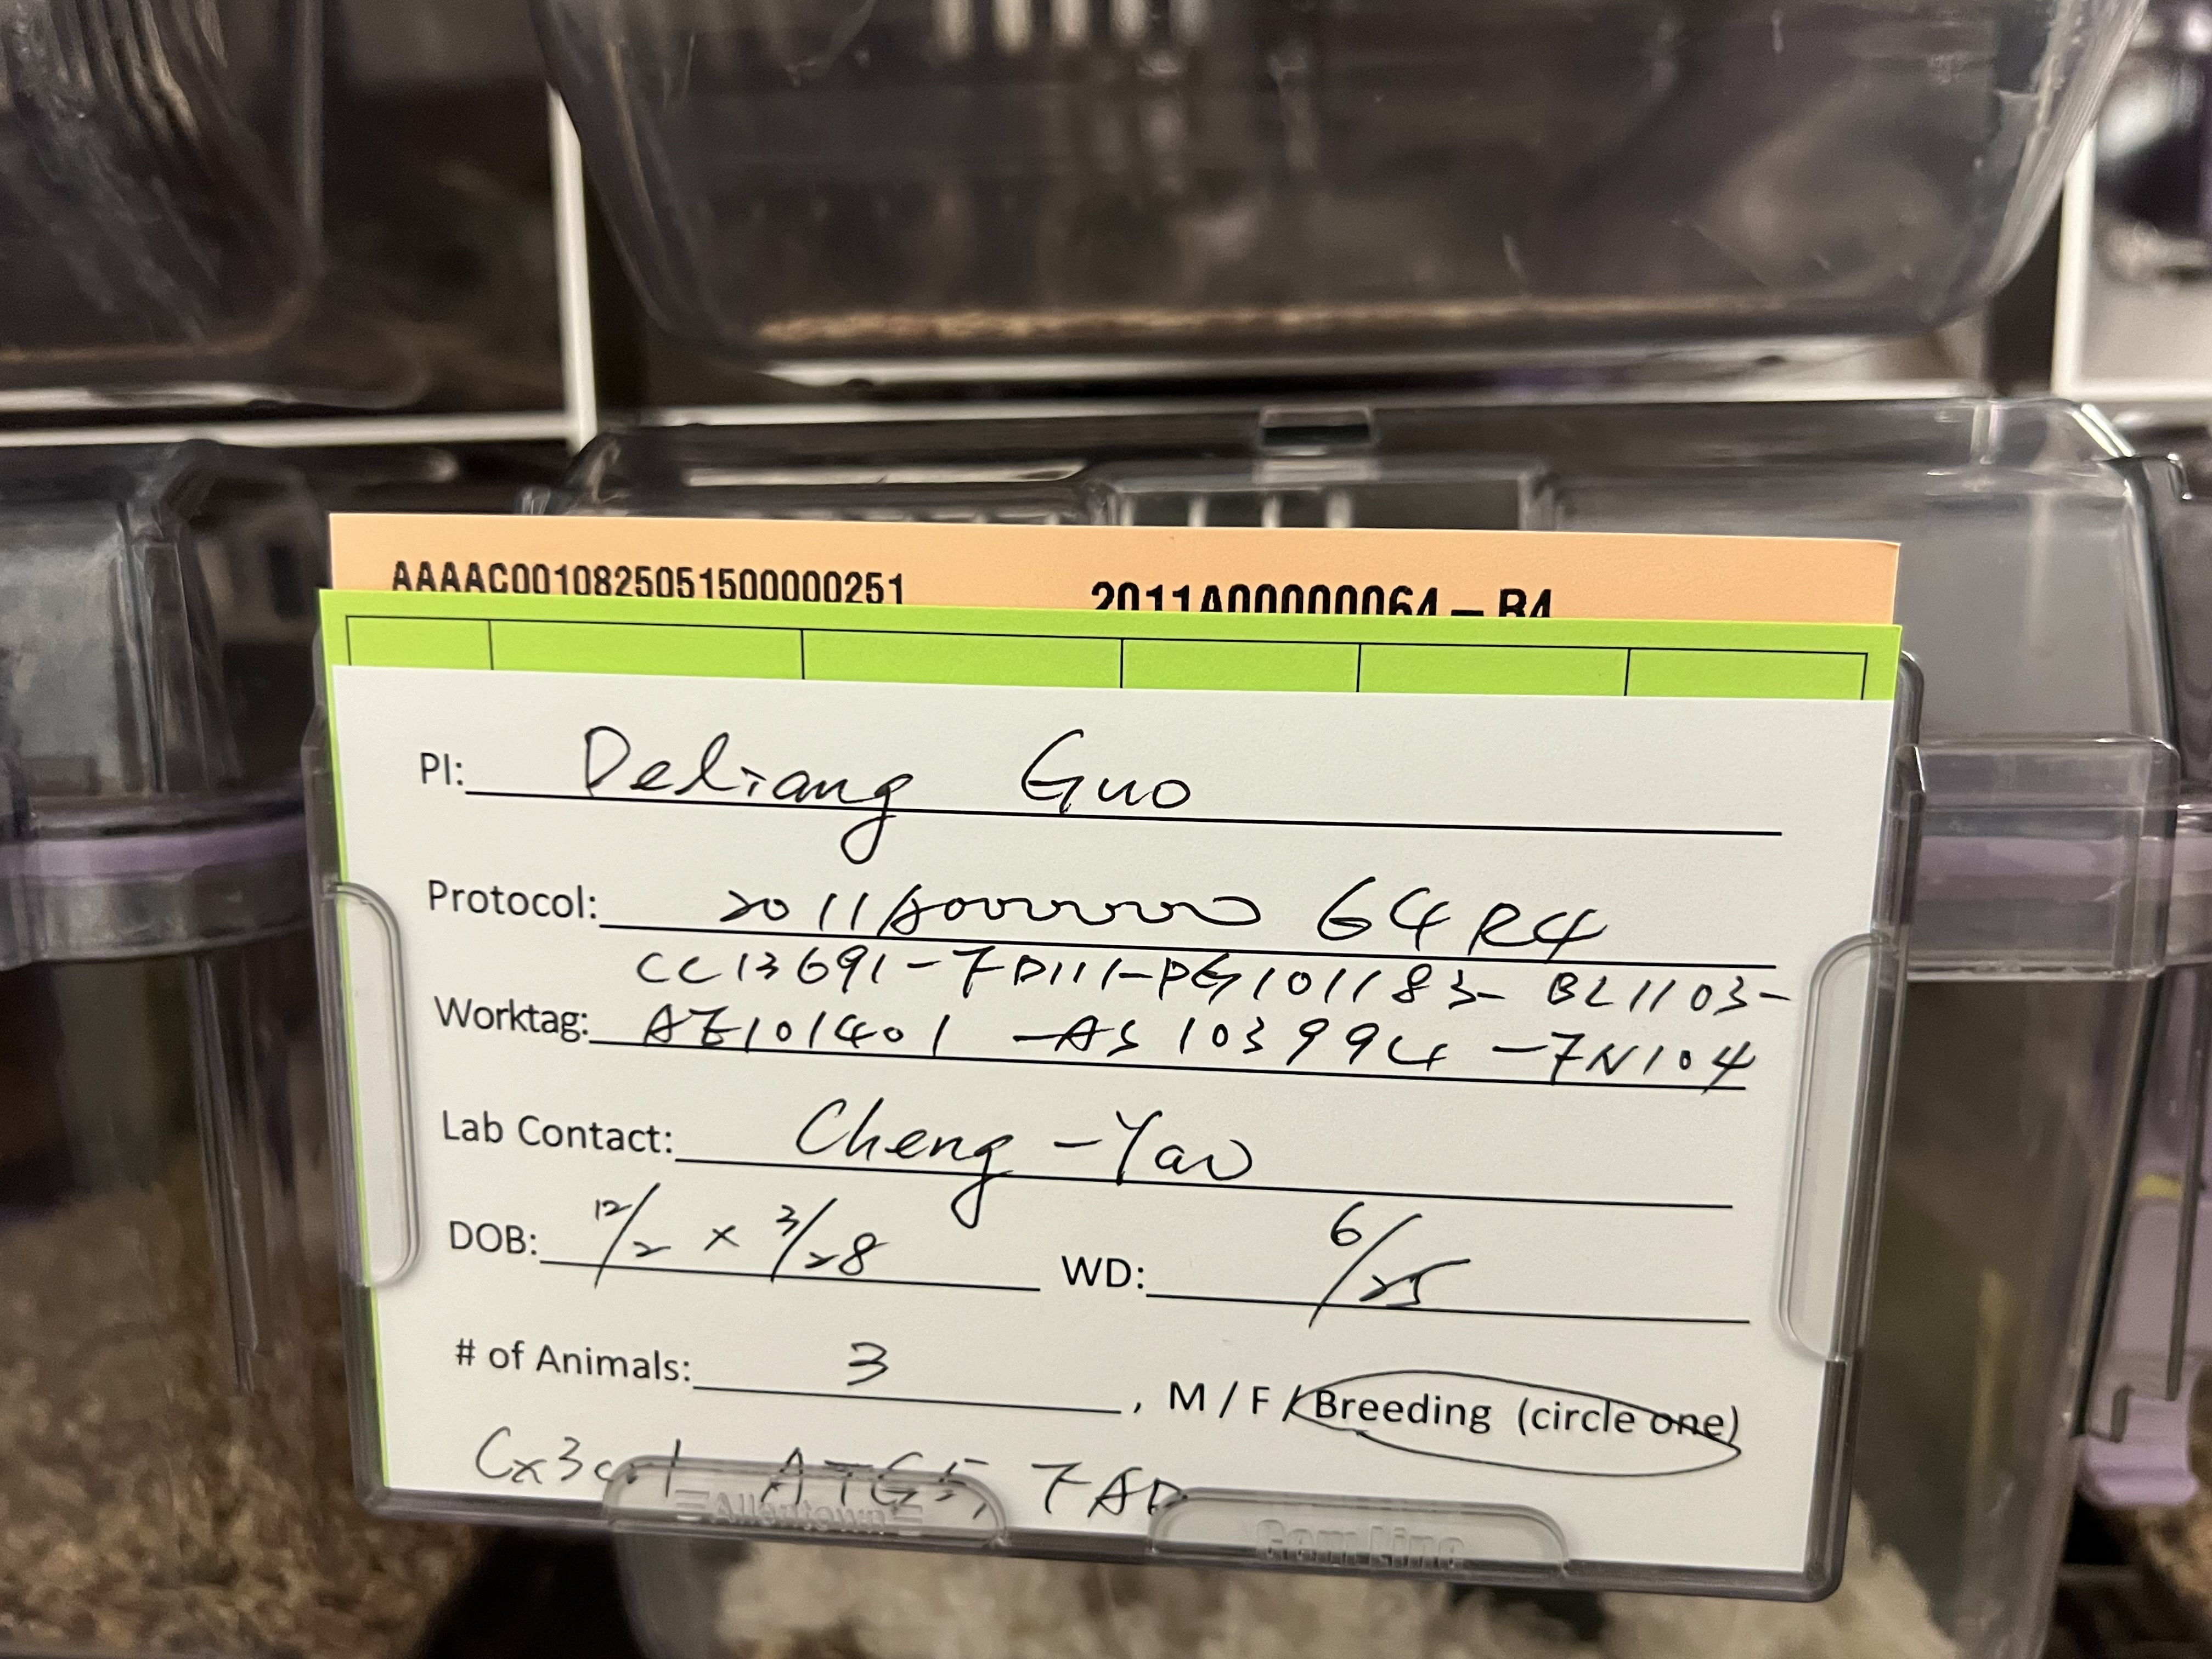
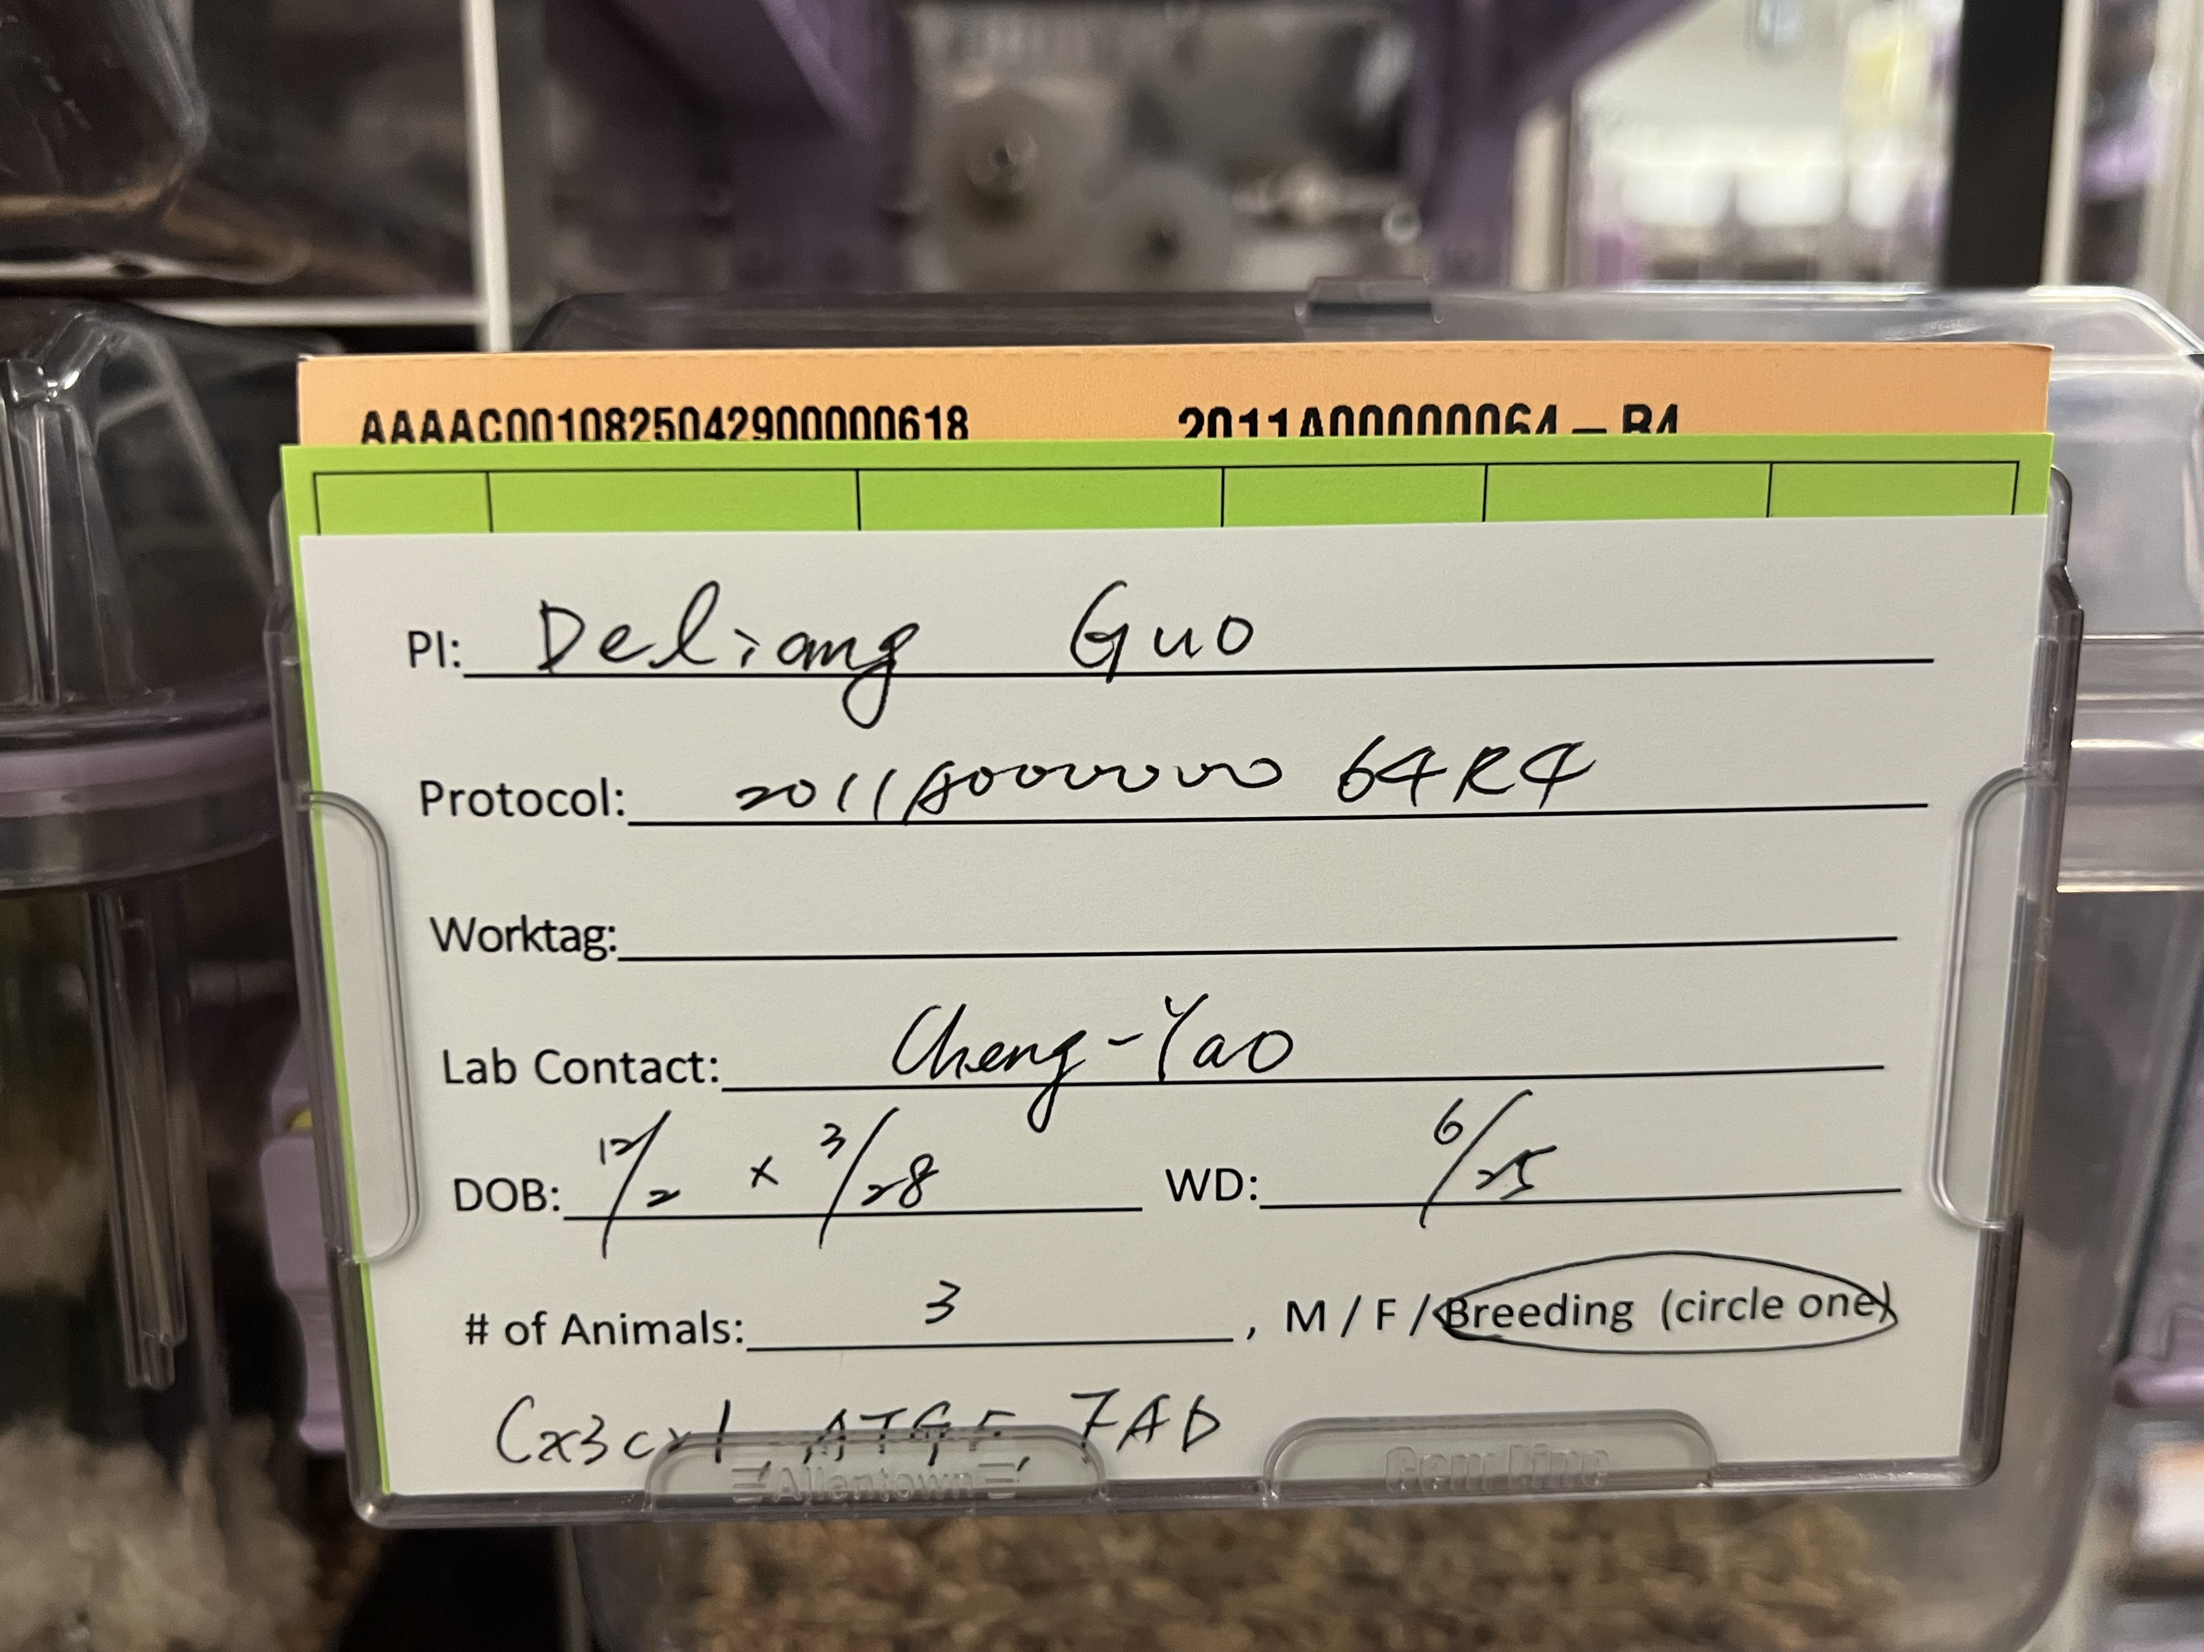
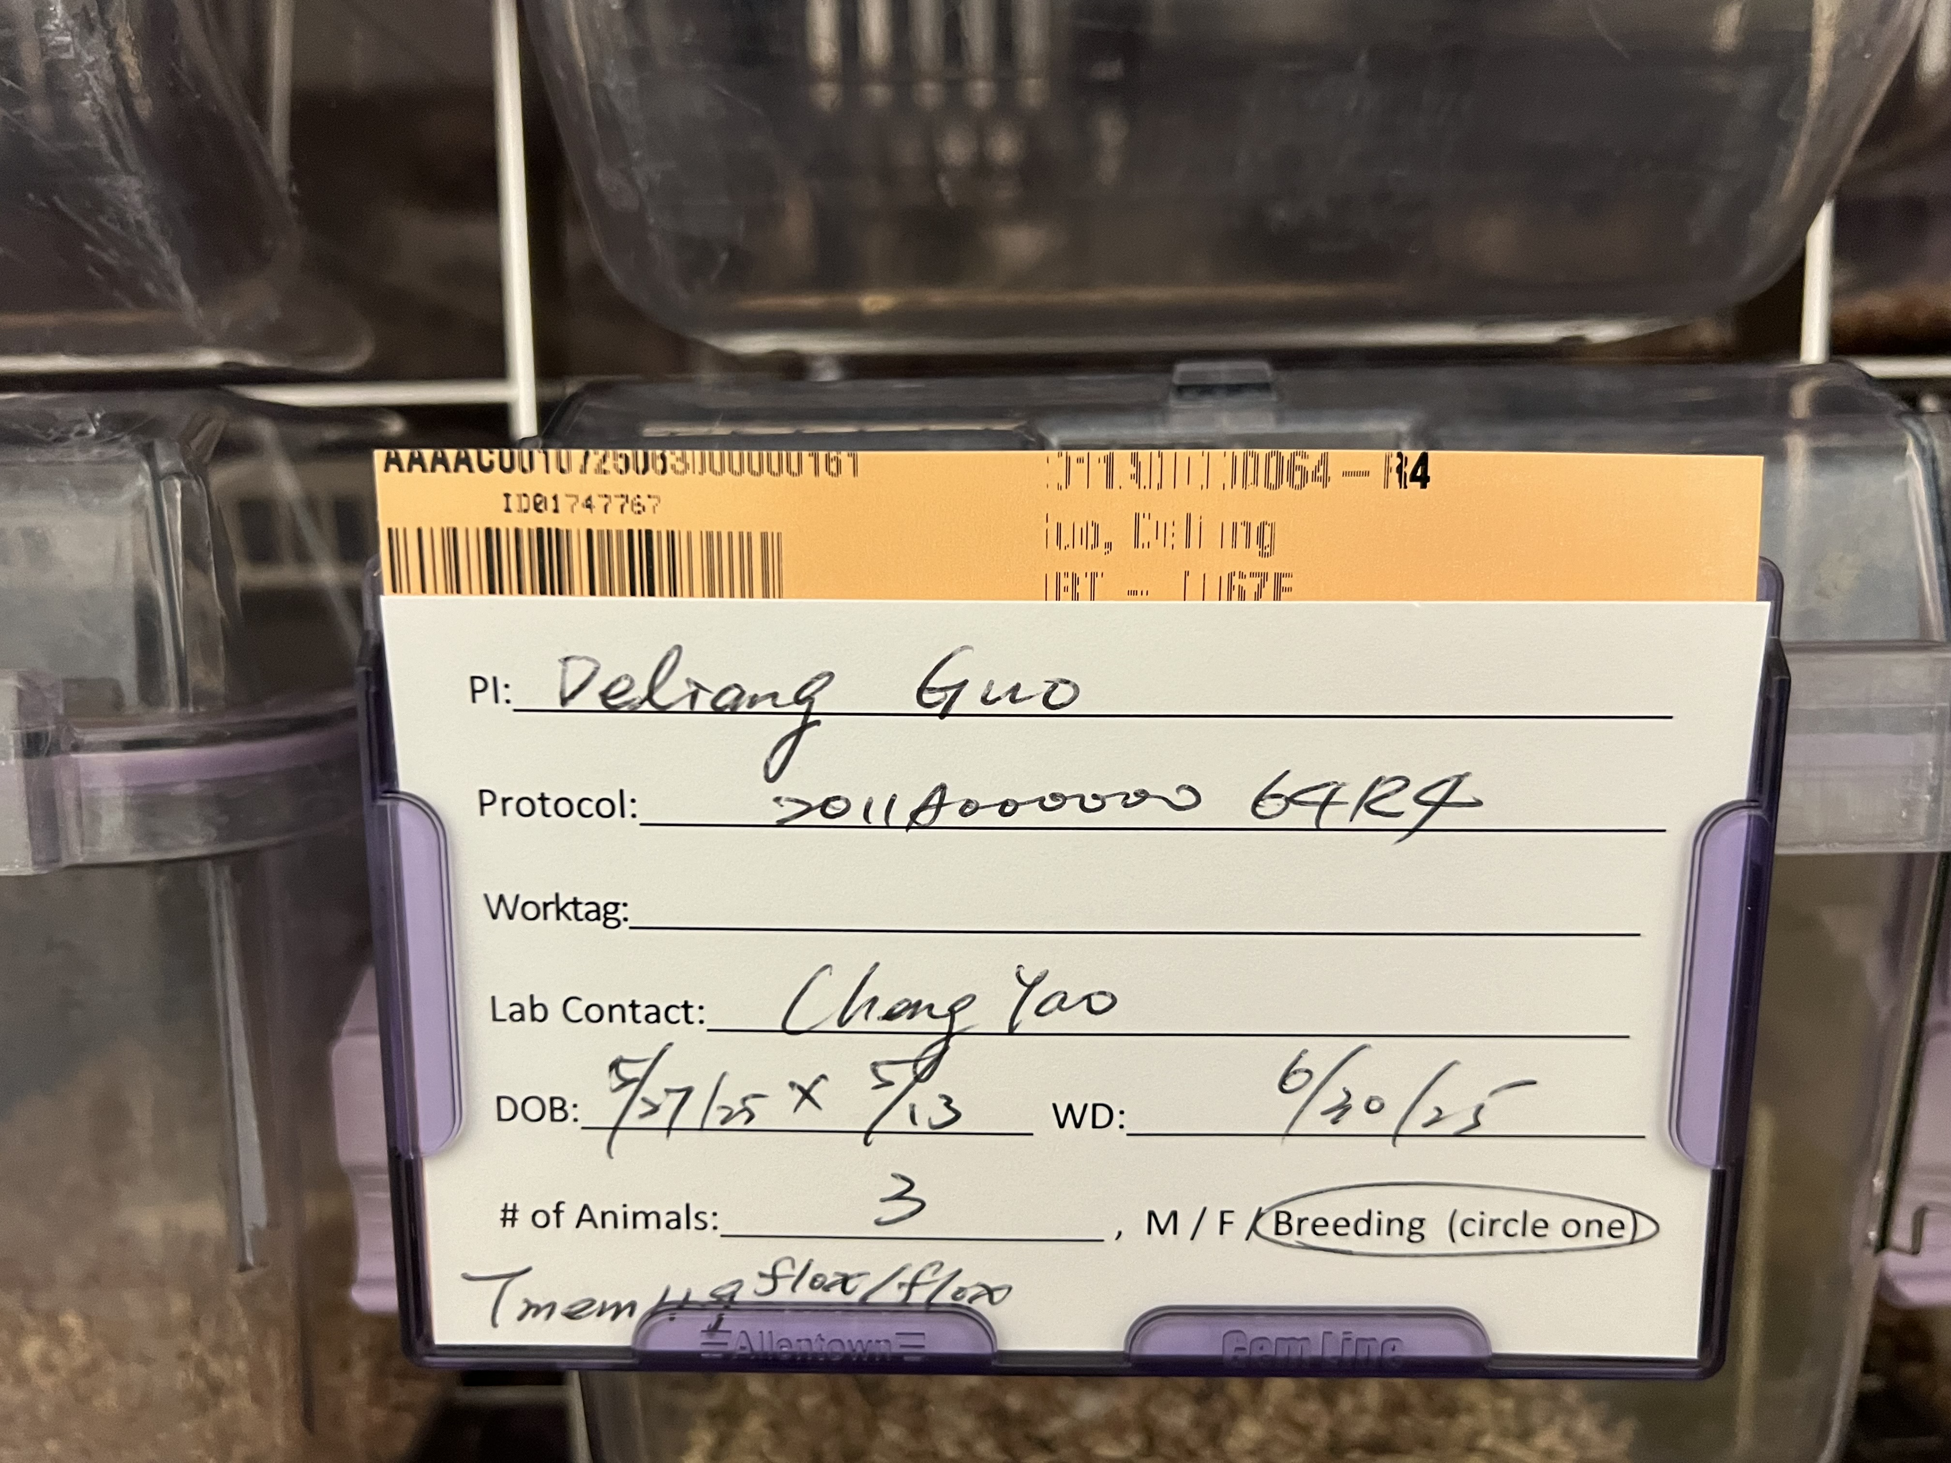
Work Summarize
1. Techniques Learned
Setting breeding cages, weaning, and designing genotype-specific breeding
Mouse genotyping (from tissue collection to PCR membrane scan)
qPCR (from cell lysis to data analysis)
Aganoe workflow (handling patient samples, single-cell plating, MH gel plating)
Macrophage collection (starch induction, flushing cells from mouse)
Western Blot (from cell lysis to membrane scan)
2. Hands on Lab Work Performed
Set up breeding cages for newly transferred Cx3cr1 and Tmem119 mouse strains
Assisted Dr. Kou with mouse genotyping
Practiced macrophage collection under Dr. Chiang’s guidance
Assisted with brain tumor injections in mice

Slide 6
Mouse Data Template
Animal Name | Life Status | Sex | Dam | Sire | Date of Birth | Body Color | Ear Tag | Protocol | Cage Name | Cage Status | Building | Room | Rack | Side | Row | Column | Owner | Genotypes
F183 | Live | Female |  |  | 9/13/24 |  | F183 | Acat1-2024 | Breeding-01 | Active | Biochemistry | 2200 |  |  |  |  | Zijie Feng | Soat1 f/f
F171 | Live | Female |  |  | 8/25/24 |  | F171 | Acat1-2024 | Breeding-01 | Active | Biochemistry | 2200 |  |  |  |  | Zijie Feng | Soat1 f/f
F073 | Live | Male |  |  | 6/19/24 |  | F073 | Acat1-2024 | Breeding-02 (8/19 setup) | Active | Biochemistry | 2200 |  |  |  |  | Zijie Feng | Soat1 f/+, TP53 f/+, PTEN f/+, Oligo-Cre +/-, Luc +/-
F256 | Live | Female |  |  | 10/1/24 |  | F256 | Acat1-2024 | Breeding-02 (8/19 setup) | Active | Biochemistry | 2200 |  |  |  |  | Zijie Feng | TP53 f/+, PTEN f/f, Luc +/-
F071 | Live | Female |  |  | 6/19/24 |  | F071 | Acat1-2024 | Breeding-02 (8/19 setup) | Active | Biochemistry | 2200 |  |  |  |  | Zijie Feng | Soat1 f/+, TP53 +/+, PTEN f/+, Oligo-Cre -/-, Luc +/-
F378 | Live | Male |  |  | 11/2/24 |  | F378 | Acat1-2024 | Breeding-04 (3/7) | Active | Biochemistry | 2200 |  |  |  |  | Zijie Feng | Soat1 f/f, LyzCre +/+
F405 | Live | Female |  |  | 11/18/24 |  | F405 | Acat1-2024 | Breeding-04 (3/7) | Active | Biochemistry | 2200 |  |  |  |  | Zijie Feng | Soat1 f/f, LyzCre +/-
F415 | Live | Female |  |  | 11/17/24 |  | F415 | Acat1-2024 | Breeding-04 (3/7) | Active | Biochemistry | 2200 |  |  |  |  | Zijie Feng | Soat1 f/f, LyzCre +/-
F440 | Live | Male |  |  | 11/30/24 |  | F440 | Acat1-2024 | Breeding-05 (3/7) | Active | Biochemistry | 2200 |  |  |  |  | Zijie Feng | Soat1 f/f, LyzCre +/+
F443 | Live | Female |  |  | 11/30/24 |  | F443 | Acat1-2024 | Breeding-05 (3/7) | Active | Biochemistry | 2200 |  |  |  |  | Zijie Feng | Soat1 f/f, LyzCre +/-
F419 | Live | Female |  |  | 11/17/24 |  | F419 | Acat1-2024 | Breeding-05 (3/7) | Active | Biochemistry | 2200 |  |  |  |  | Zijie Feng | Soat1 f/f, LyzCre +/-
F376 | Live | Male |  |  | 11/2/24 |  | F376 | Acat1-2024 | Breeding-06 (3/7) | Active | Biochemistry | 2200 |  |  |  |  | Zijie Feng | Soat1 f/f, LyzCre +/+

